Slide 1
GFRC FACADES
THE CORNICE

Slide 2
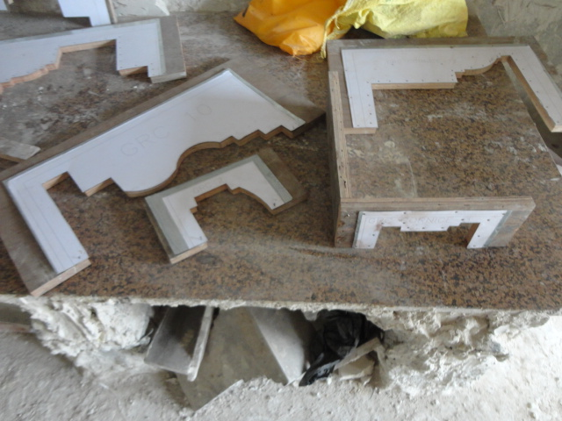
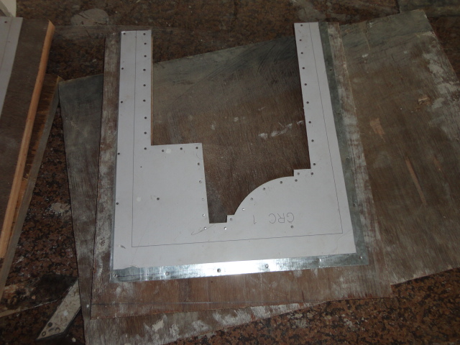
PROFILE OF A ELEMENT
AS PER CAD DETAIL PROVIDED . THE FIRST STAGE INTO PROCESS OF MANUFACTURING A MOLD

Slide 3
CORNICE
is generally any horizontal decorative moulding that crowns a building — generally a cornice does demarcate a floor for instance, or the cornice around the top edge of a exterior or interior wall.
The important function of the projecting cornice in a building is to throw rainwater free of the building’s walls. In residential building practice and a cornice has a decorative aspect to it as well.

Slide 4
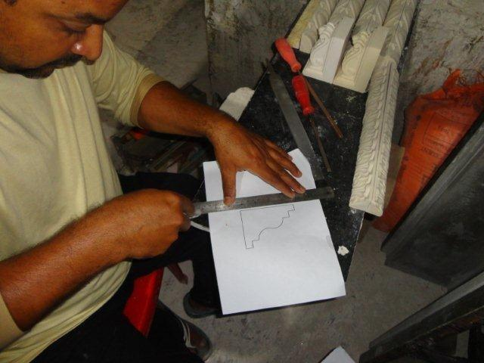
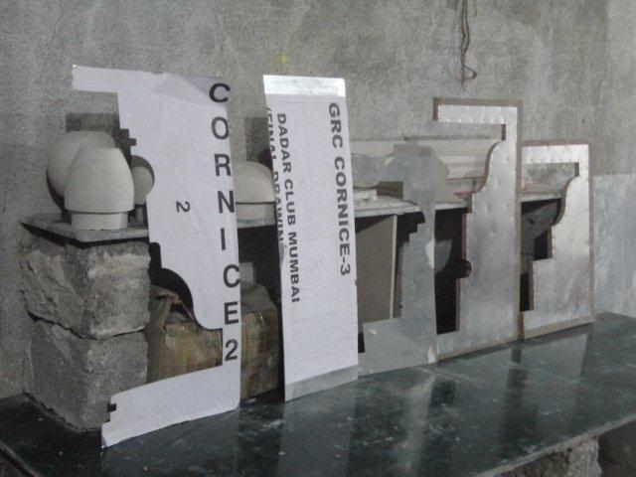
THE PATTERN CUTTING –
THE FIRST STEP TO MOLD MAKING

Slide 5
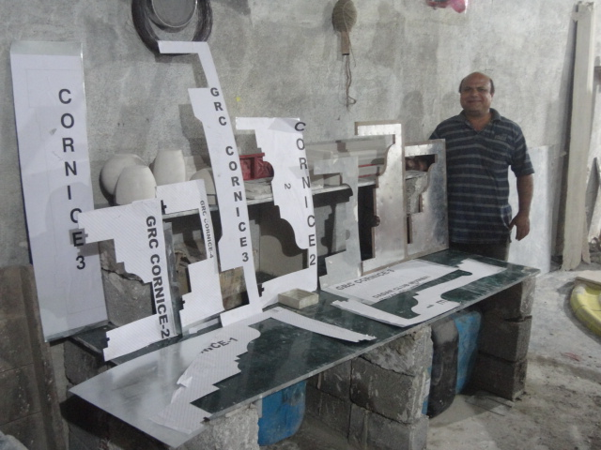
THE VARIOUS PATTERN PROFILE CUTTING FRAMES

Slide 6
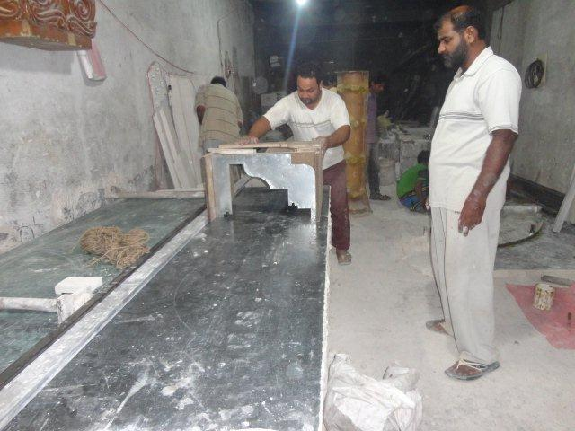
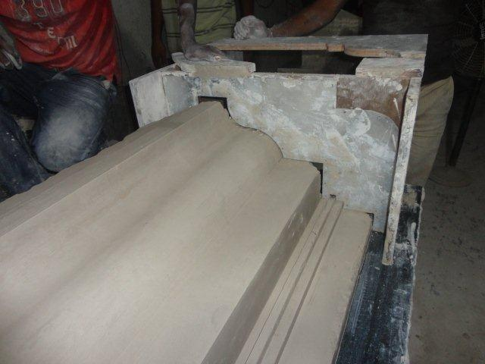
PATTERN MADE IN POP
A PROCESS WITH GREAT EFFORT & LABOUR

Slide 7
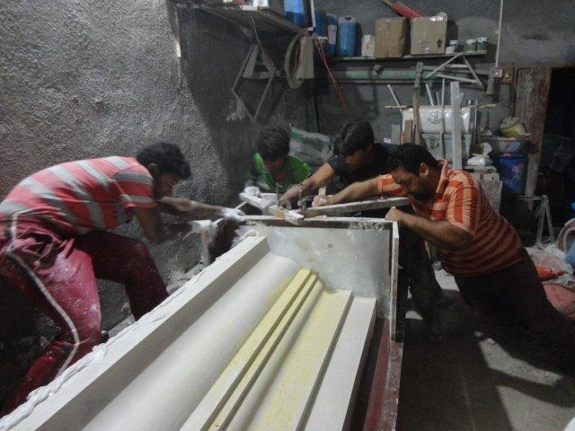
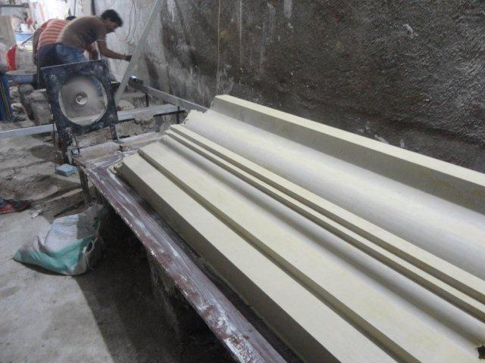
PROCESS OF RUNNING OVER THE METAL PATTERN OVER THE POP TILL A SMOOTH DESIRED FINISH IS ACHIEVED, IS REPEATED MANY TIMES TO ACHIEVE THE DESIRED SHARPNESS AND FINISH . THIS IS THE EFFORT & LABOUR INVOLVED

Slide 8
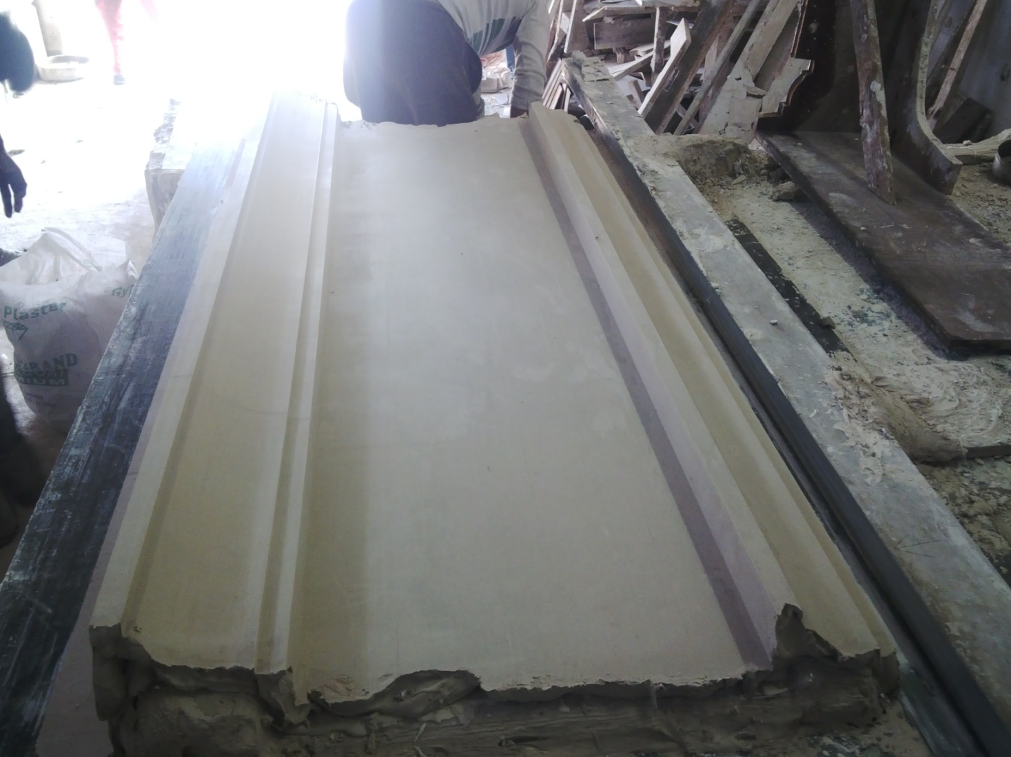
POP PATTERN
OF A CORNICE PROFILE

Slide 9
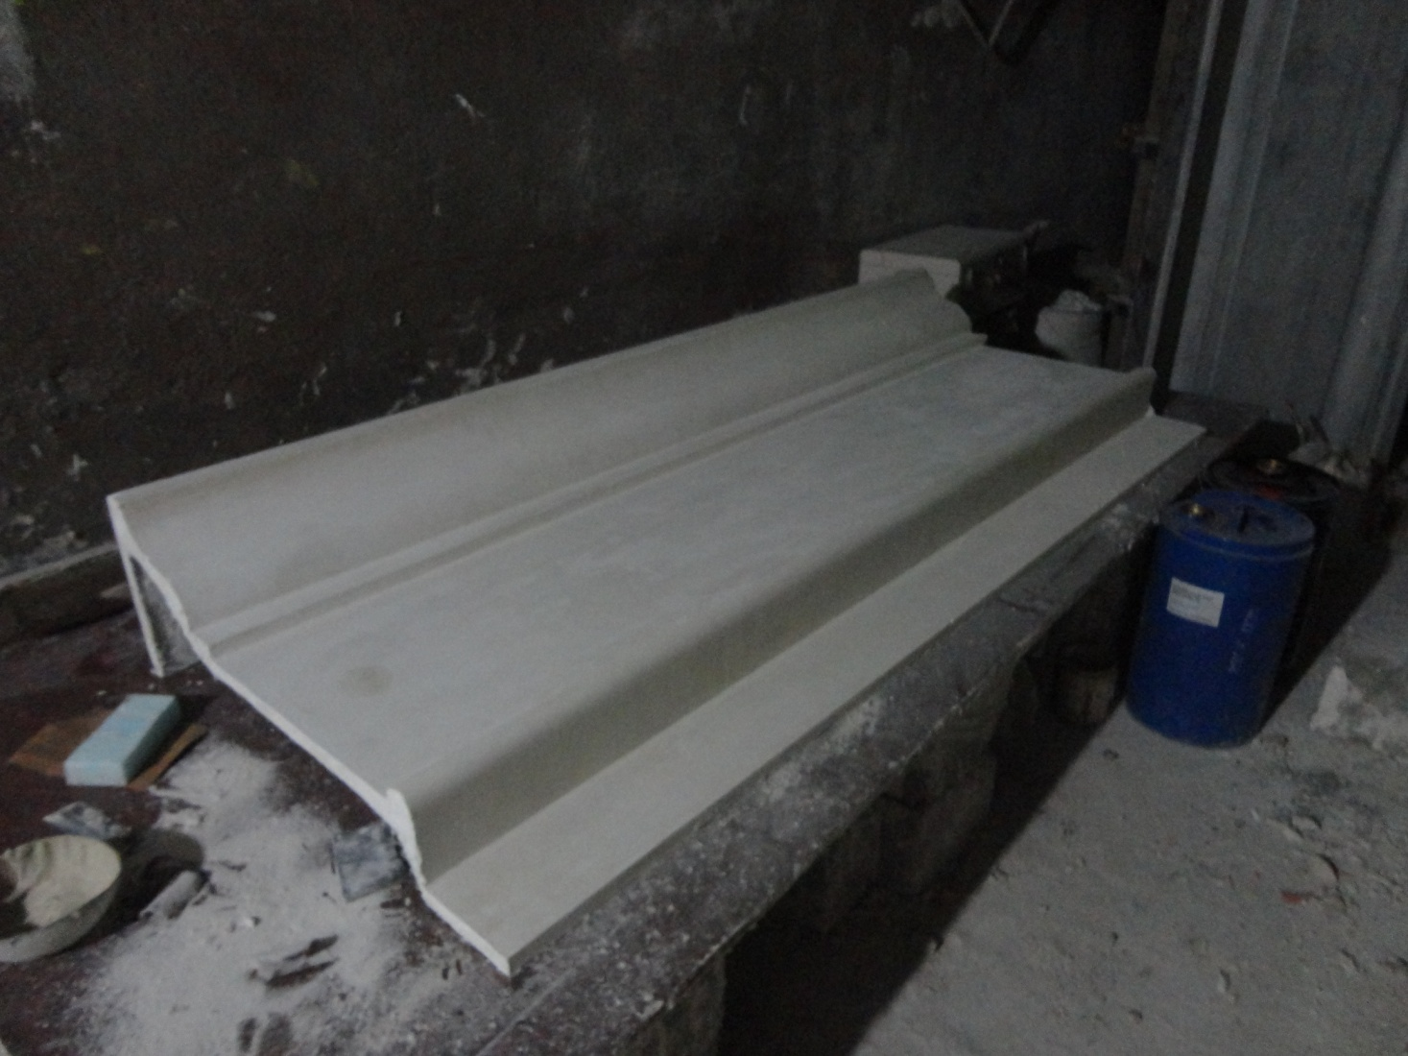
POP PATTERN
OF A CORNICE PROFILE

Slide 10
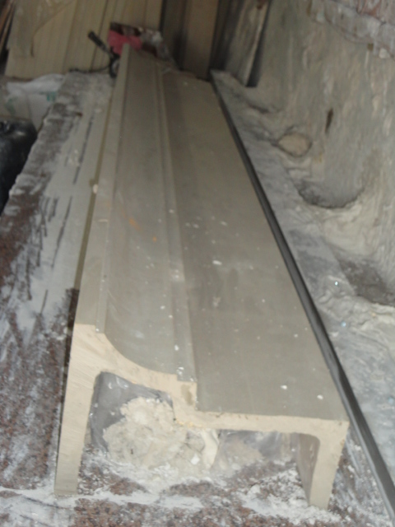
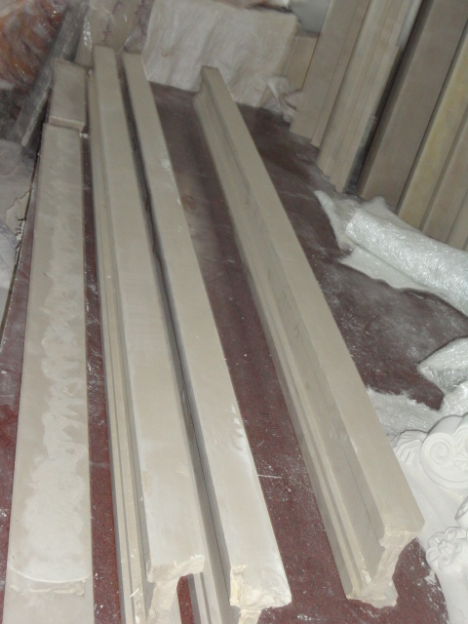
POP PATTERN
OF A CORNICE PROFILE

Slide 11
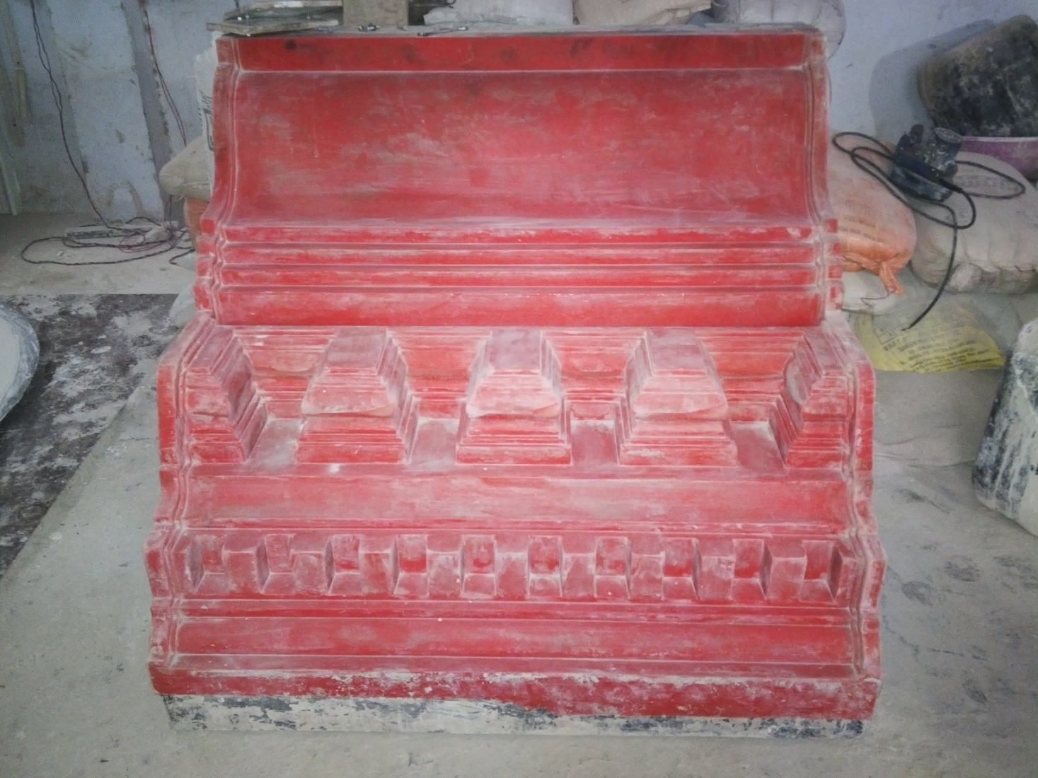
RUBBER MOLD
OF A DECORATIVE CORNICE

Slide 12
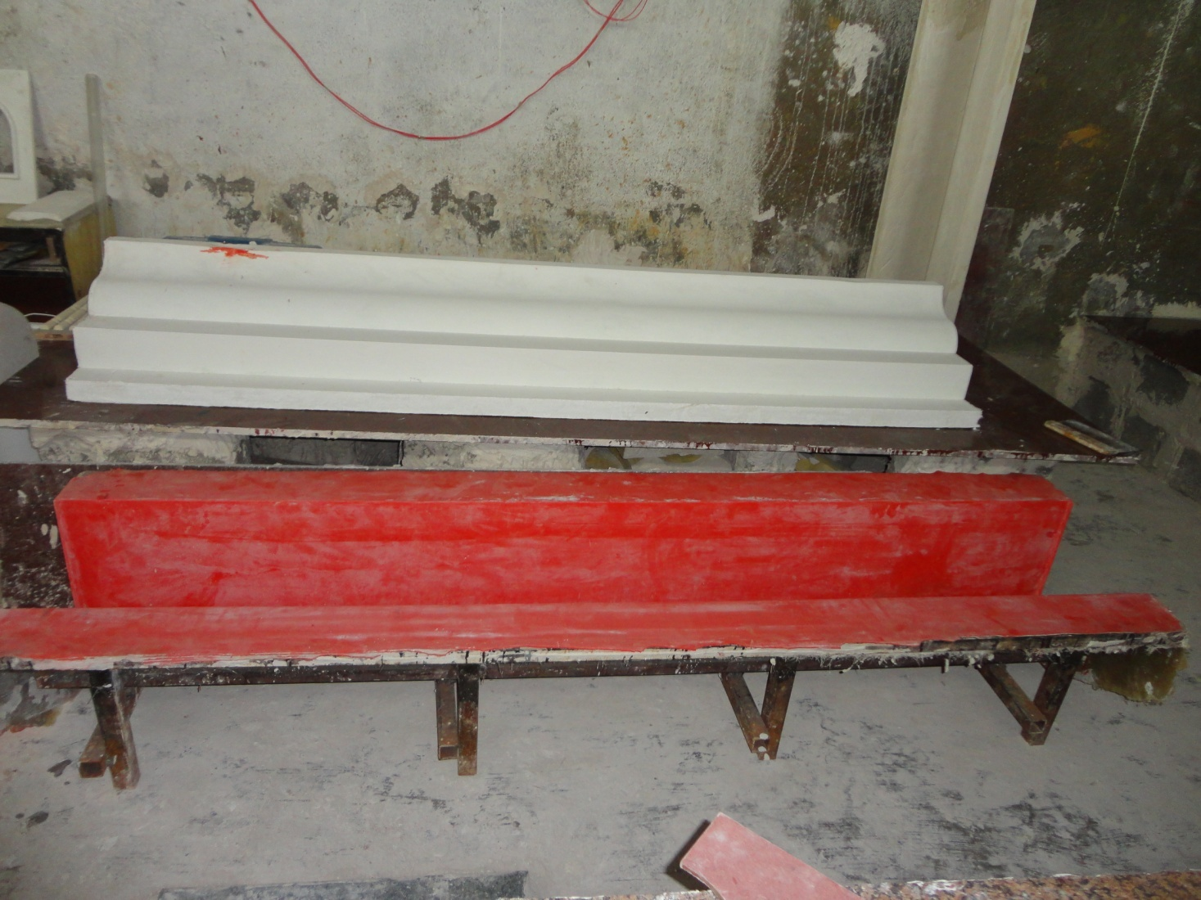
THE GRC ELEMENT & ITS MOLD

Slide 13
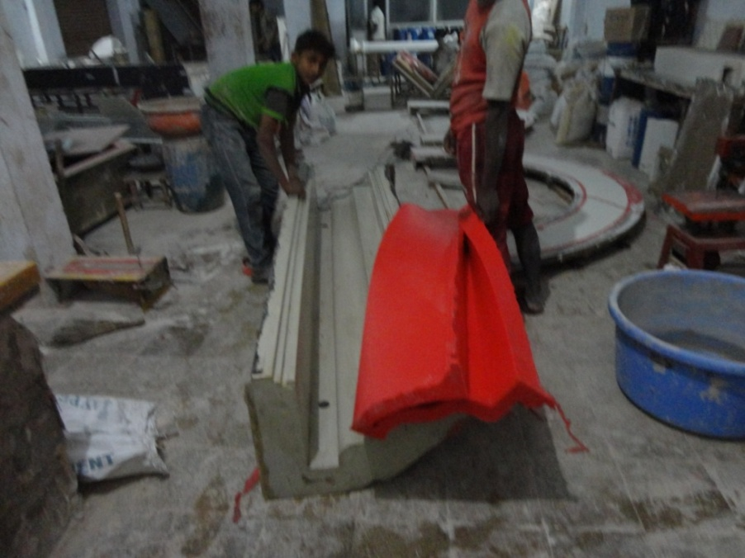
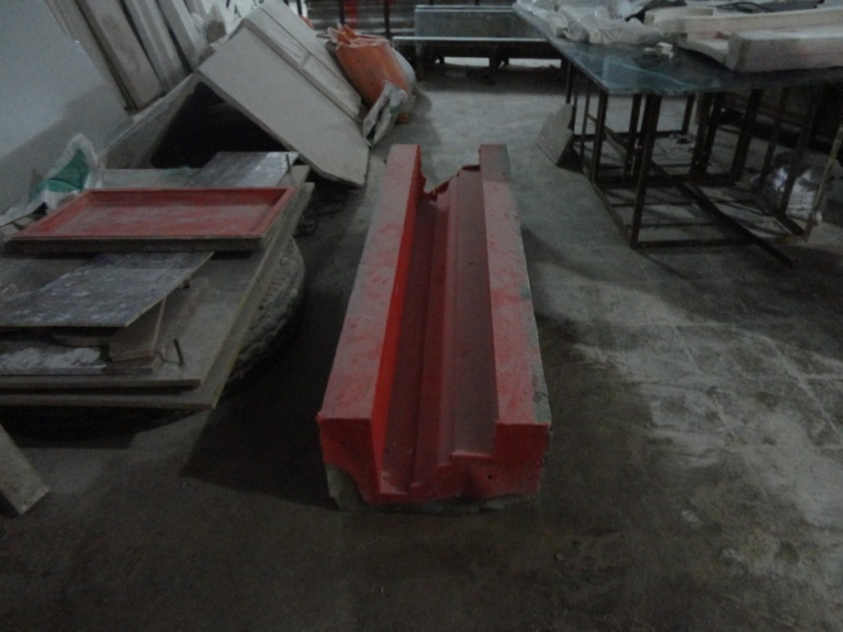
FACE RUBBER MOLD & ITS BACK MOLD IN FRP

Slide 14
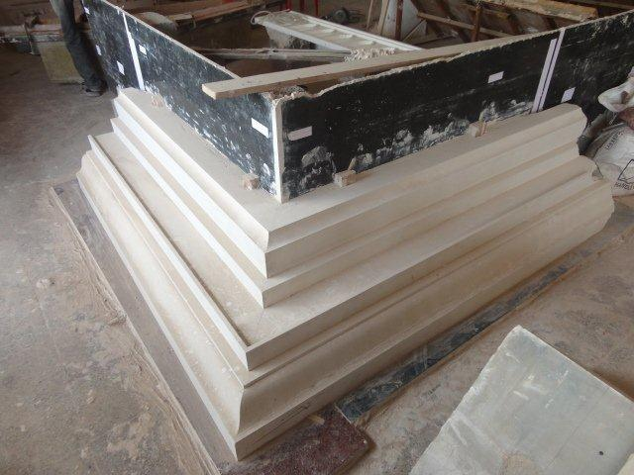
AS DESIRED BASED ON THE CAD DETAILS CORNER PROFILE - THE ELEMENTS ARE CUT TO SIZE AND FINISHED

Slide 15
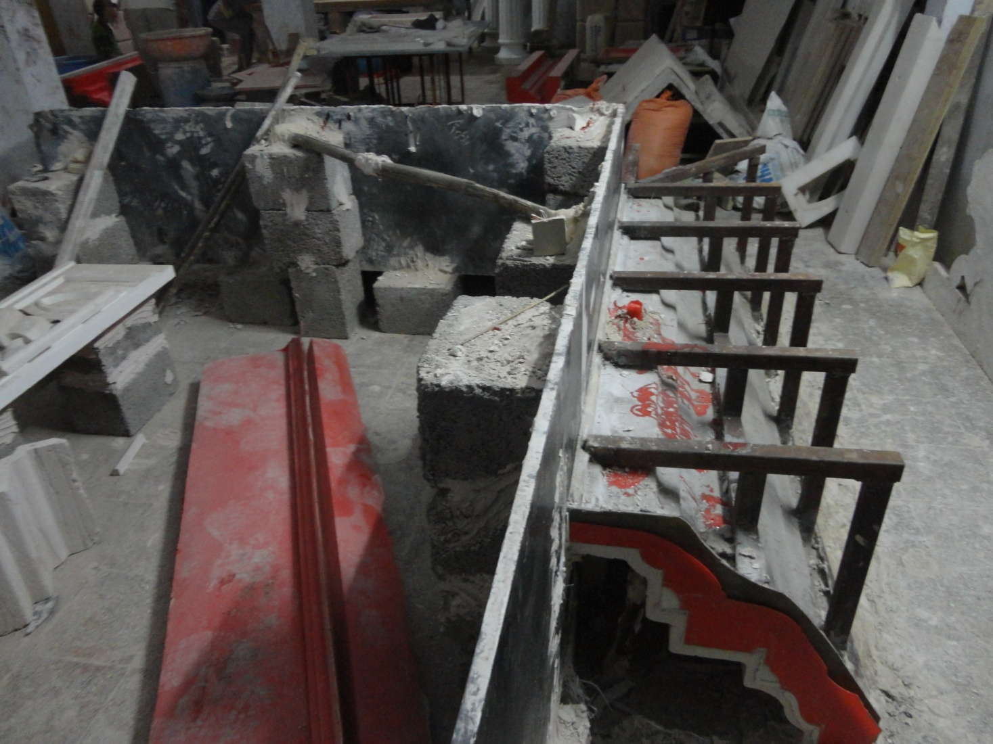
MOLD MAKING IN PROCESS
ONE CAN CLEARLY SEE THE VERTICAL STONE PANEL , THEN THE THIN POP PATTERN IN WHITE, THEN THE RED RUBBER FACE MOLD & THEN THE FRP BACK MOLD ALONG WITH THE FABRICATION WORK TO GIVE THE ENTIRE MOLD A LEVEL & STABILITY TO RETAIN THE GIVEN SHAPE DURING CASTING OF GRC.

Slide 16
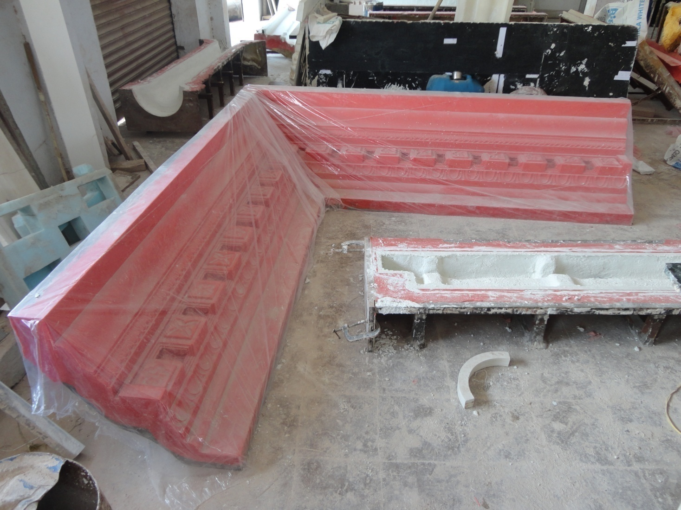
THE DECORATIVE RUBBER MOLD
TO ACHIEVE A FINISH AS DESIRED, ESPECIALLY TO ACHIEVE DETAILED DESIGN WORK, A RUBBER MOLD IS A MUST – IT ADDS TO COST

Slide 17
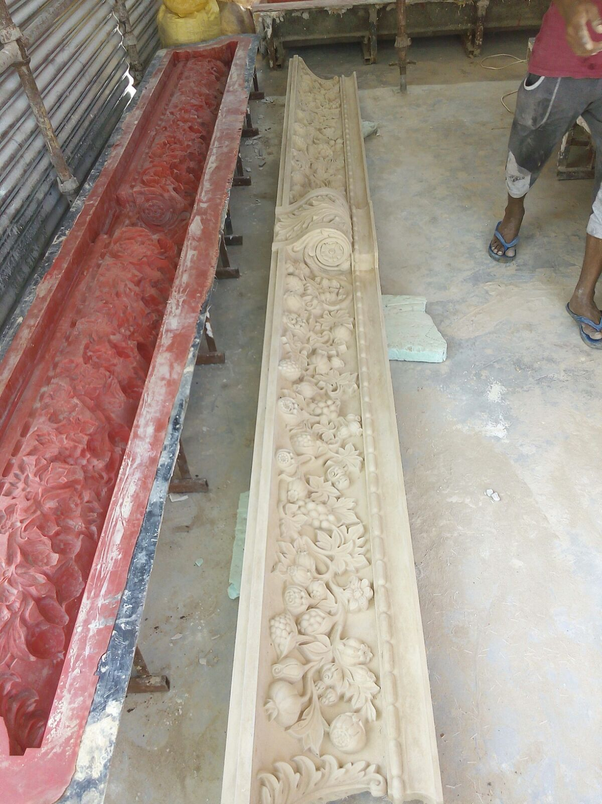
DECORATIVE CORNICE
SUCH DECORATIVE CORNICES SHOULD BE MADE IN A RUBBER MOLD ONLY, AS THE DETAILED FEATURES WITH THE DESIRED FINISH WILL BE ACHIEVED.
EVERY RUBBER MOLD WILL ALWAYS HAVE A BACK MOLD FOR THE RUBBER TO BE STABLE AND IN POSITION.
IT IS VERYIMPORTAIN TO NOTE THAT USING RUBBER MOLDS CIST IS AT LEAST 3 TIMES COSTLIER THEN FRP MOLDS

Slide 18
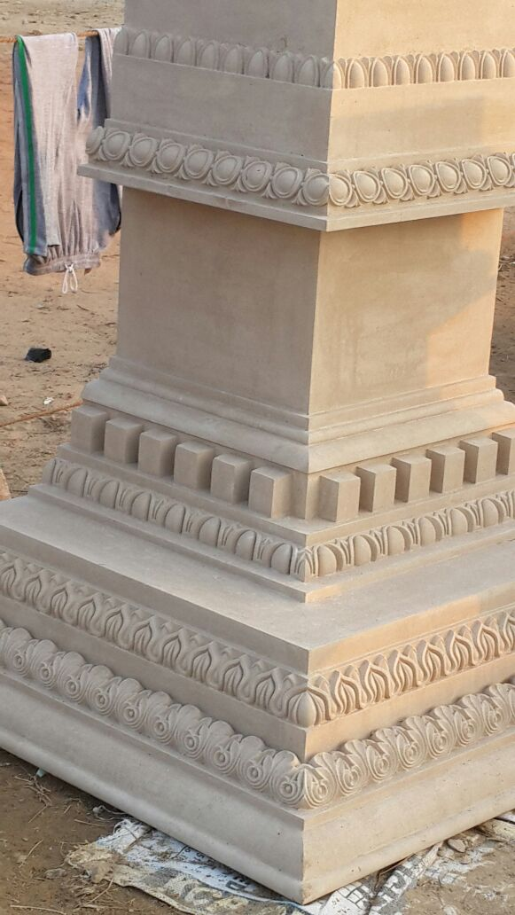
CORNICE CORNER ELEMENT
IN THE EXTERNAL & INTERNAL CORNERS WE DO TAKE CARE TO CREATE EXTRA / SPECIAL MOULDS SO THAT THERE IS PERFECTION & SYMETRY TO THE CORNICE.
NON OF THE MANUFACTURERS TAKE THAT EXTRA PAIN / COST TO CREATE THESE DETAILS.

Slide 19
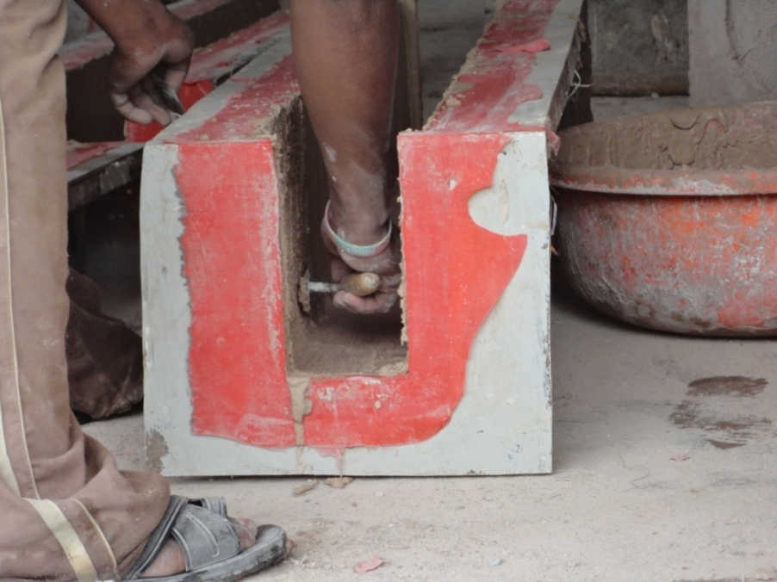
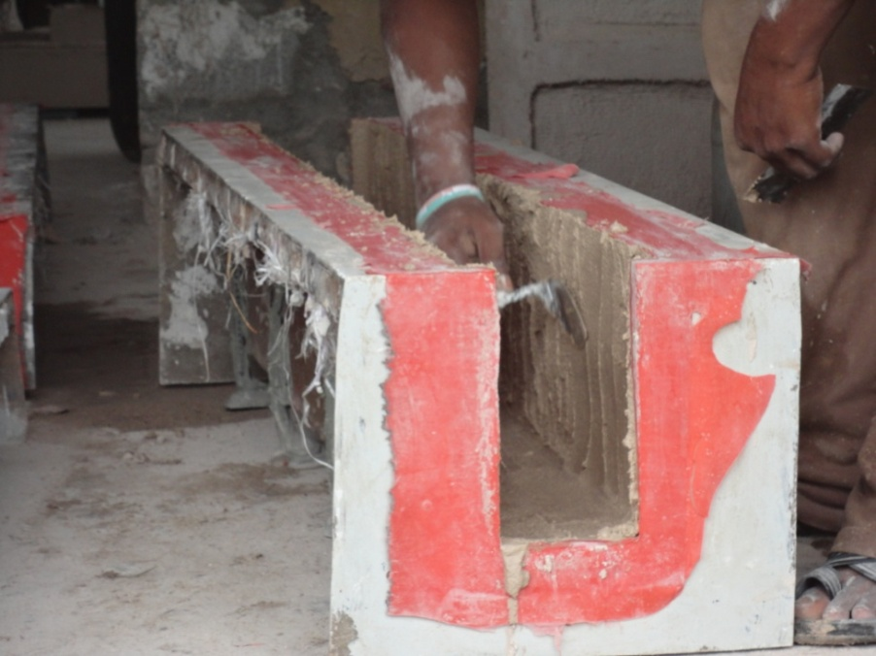
GRC CASTING IN A RUBBER MOLD

Slide 20
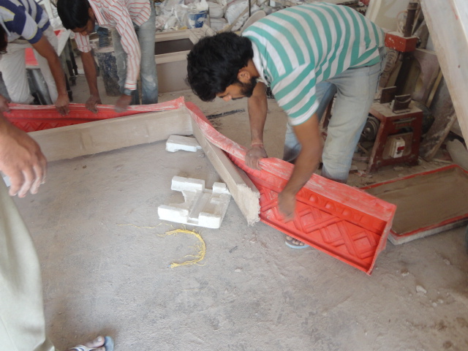
RELEASING GRC ELEMENT FROM A RUBBER MOLD

Slide 21
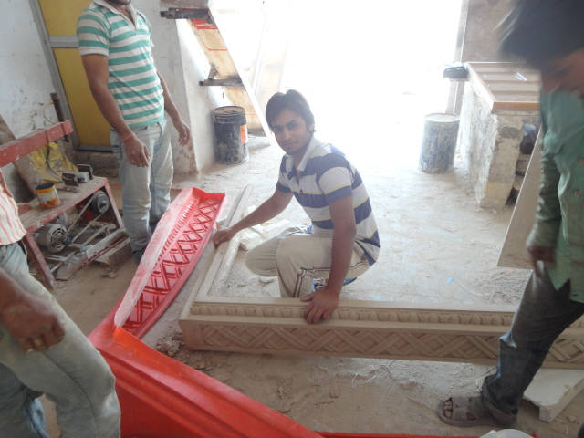
RELEASING GRC ELEMENT FROM A RUBBER MOLD

Slide 22
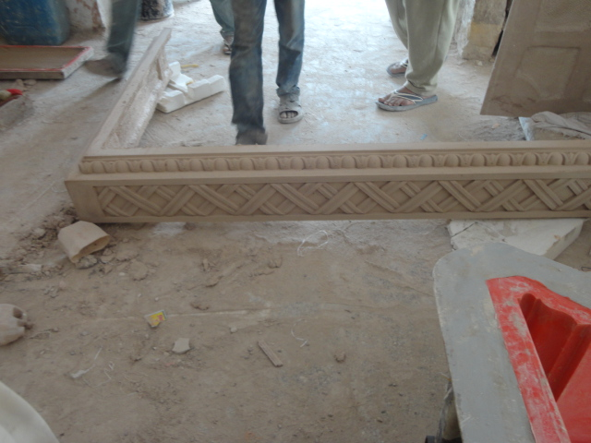
THE DECORATIVE GRC CORNICE

Slide 23
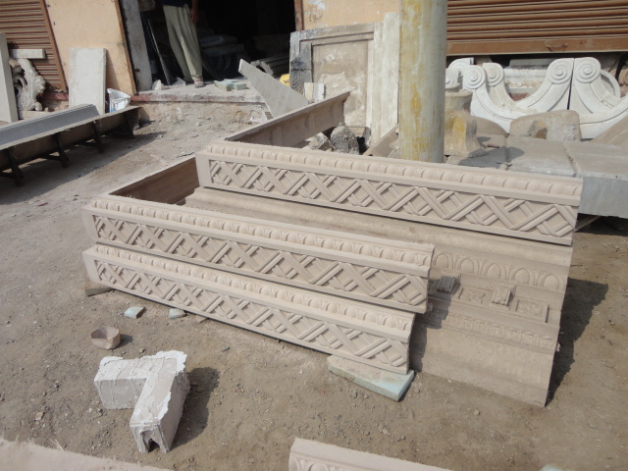
THE DECORATIVE GRC CORNICE

Slide 24
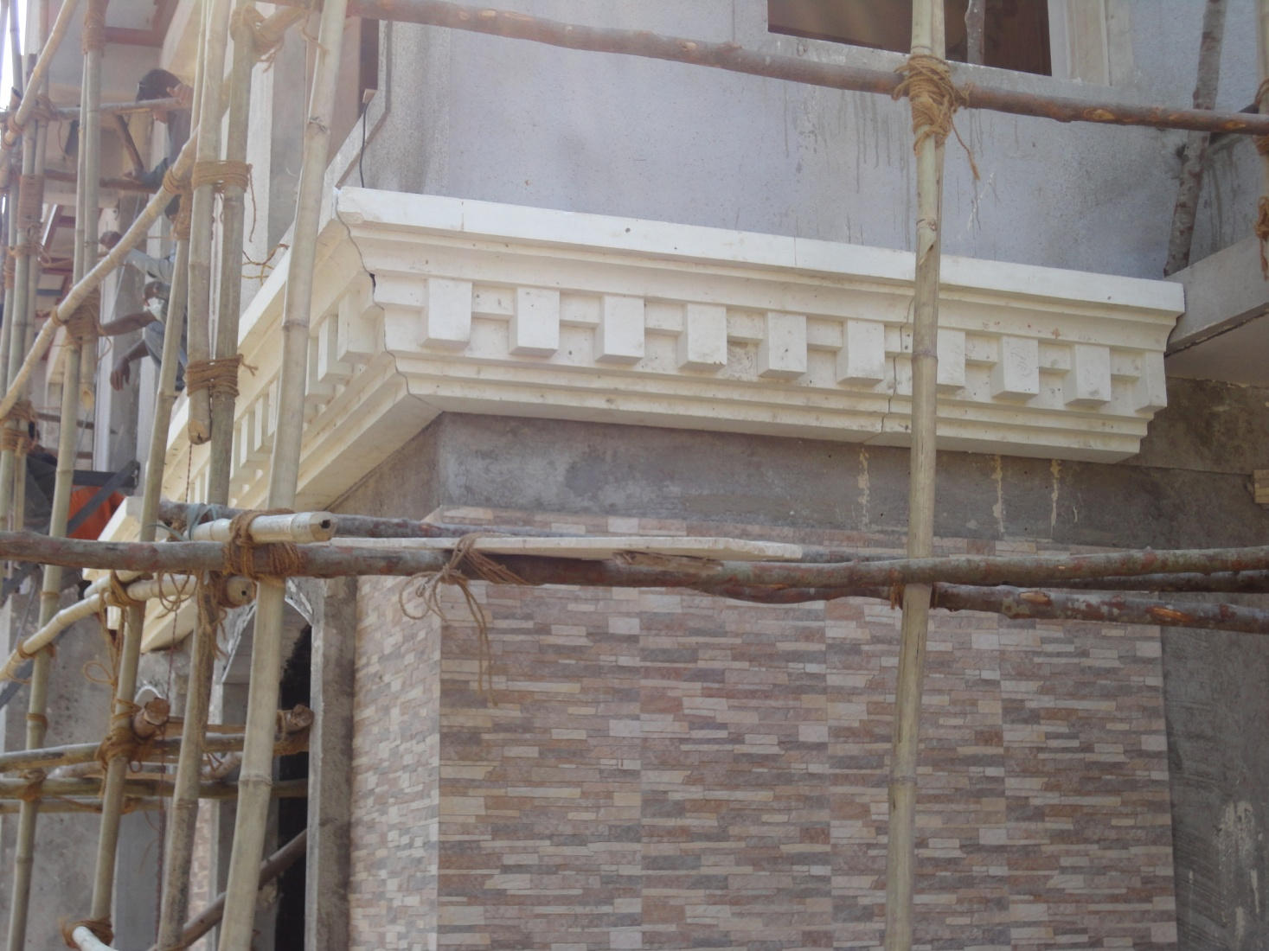
THE DECORATIVE GRC CORNICE INSTALLED AT SITE

Slide 25
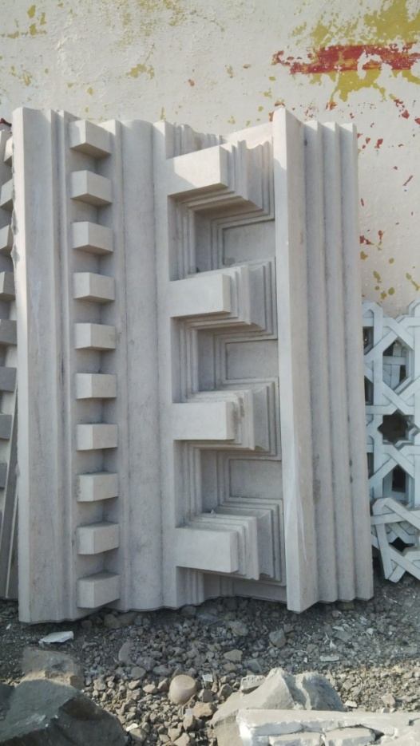
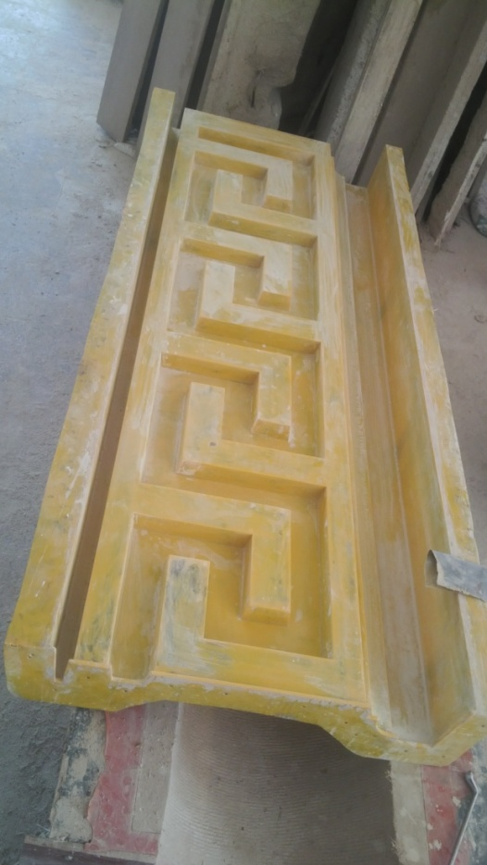
CREATING WONDERS WITH GFRC
GRC CORNICE
FRP MOLD

Slide 26
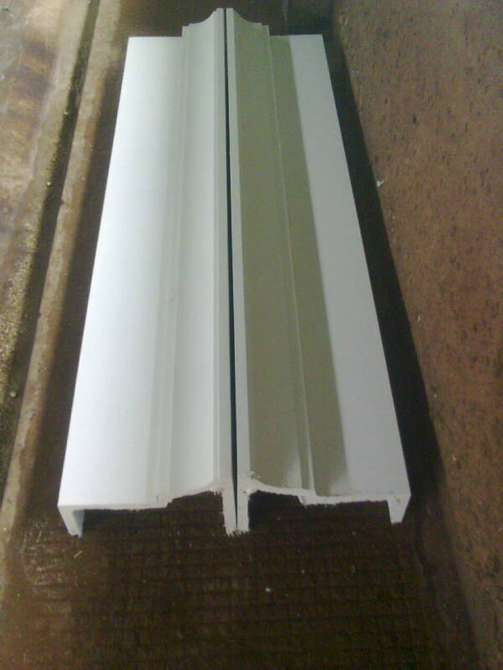
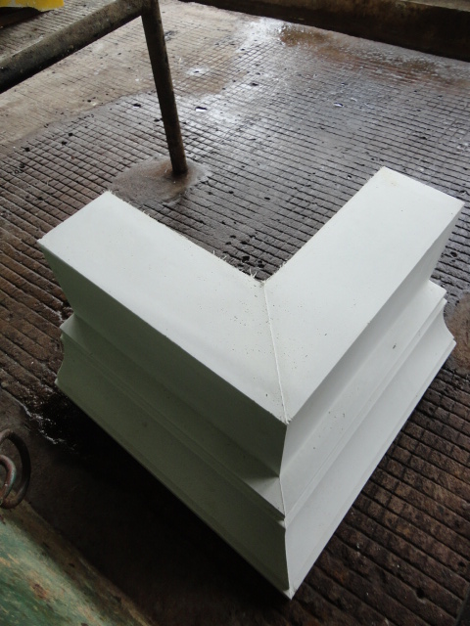
CREATING WONDERS WITH GFRC
GRC CORNICE
CORNER OF A CORNICE

Slide 27
GFRC FACADES – MUMBAI
SRIHARI NILKAR
9867569395
nilkarsrihari@gmail.com

